Slide 1





Basic C# part 6
Teodora Berende
Proiect cofinantat din Fondul Social European prin Programul Operational Capital Uman 2014-2020

Slide 2


AGENDA
Inheritance
Abstract class
Interfaces
Class Inheritance vs Abstract class vs Interface
Polymorphism
Overriding
Overloading
Access modifiers
Static class & members
Proiect cofinantat din Fondul Social European prin Programul Operational Capital Uman 2014-2020

Slide 3

Inheritance
Image by <a href="https://www.freepik.com/free-vector/family-tree-with-blue-circles-green-leaves-flat-design_1060221.htm">Freepik</a>
Proiect cofinantat din Fondul Social European prin Programul Operational Capital Uman 2014-2020

Slide 4
INHERITANCE
Core concept of object-oriented programming (OOP)
Creating new classes based on existing ones. A class inherits another class / A class is derived from another class, thus creating a hierarchy of classes that share a set of common attributes and methods -> Code Reusability
Example of usings:
map real life objects that share common attributes
adding custom logic to existing code or frameworks
declaring different kinds of exceptions
Proiect cofinantat din Fondul Social European prin Programul Operational Capital Uman 2014-2020

Slide 5
Practice TIME
Inheritance
Proiect cofinantat din Fondul Social European prin Programul Operational Capital Uman 2014-2020

Slide 6

Abstract Class
Proiect cofinantat din Fondul Social European prin Programul Operational Capital Uman 2014-2020

Slide 7
ABSTRACT CLASS
A template used to define a common set of attributes and methods for a category of objects.
Use abstract word to declare it
Can’t be instantiated!
Can contain abstract methods – only the declaration of a method. They must be implemented in the derived classes.
Proiect cofinantat din Fondul Social European prin Programul Operational Capital Uman 2014-2020

Slide 8
Practice TIME
Abstract class
Proiect cofinantat din Fondul Social European prin Programul Operational Capital Uman 2014-2020

Slide 9
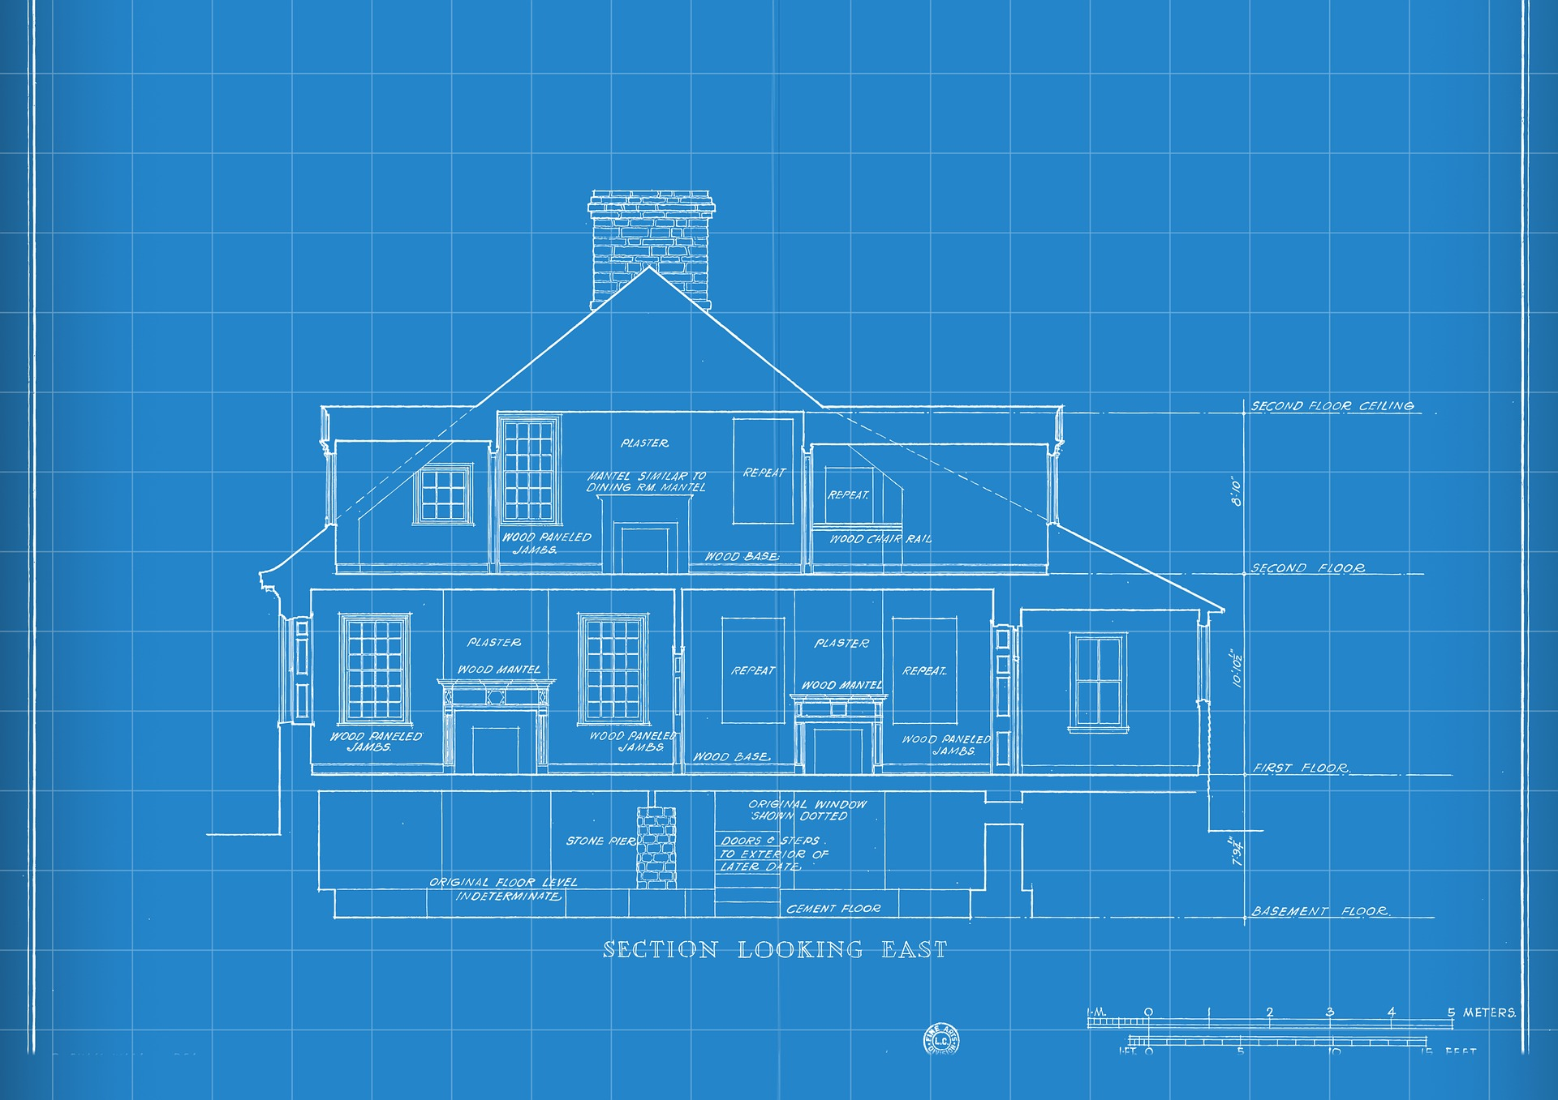
Interfaces
Proiect cofinantat din Fondul Social European prin Programul Operational Capital Uman 2014-2020

Slide 10
INTERFACES
Contains the definitions of the methods that a class must implement!
abstract type
Proiect cofinantat din Fondul Social European prin Programul Operational Capital Uman 2014-2020

Slide 11
Practice TIME
Interfaces
Proiect cofinantat din Fondul Social European prin Programul Operational Capital Uman 2014-2020

Slide 12
Class Inheritance vs Abstract class vs Interface
CLASS
Can be instantiated
Allows to implement functionality
Derived class can inherit only 1 class
Abstract class
Can’t be instantiated
Allows to implement functionality
Derived class can inherit only 1 abstract class
Hides details of the implementation
Interface
Can’t be instantiated
Just define the body of the functionality
Derived class can inherit multiple interfaces
Proiect cofinantat din Fondul Social European prin Programul Operational Capital Uman 2014-2020

Slide 13

POLYMORPHISM
Proiect cofinantat din Fondul Social European prin Programul Operational Capital Uman 2014-2020

Slide 14
POLYMORPHISM Greek word that means "many-shaped"
OVERRIDING
Occurs between parent and child classes
Provides extended implementations and readability of the same method
Parameters must be the same
Return type must be the same
Runtime polymorphism
OVERLOADING
Occurs in the same class
Provides specific implementation to each class
Parameters must be different
Return type can be the same or different
Compile time polymorphism
Proiect cofinantat din Fondul Social European prin Programul Operational Capital Uman 2014-2020

Slide 15
POLYMORPHISM Greek word that means "many-shaped"
OVERRIDING
Occurs when the method signature is the same in the parent class and the child class.
OVERLOADING
Overloading occurs when two or more methods in the same class have the same name but different parameters.
Proiect cofinantat din Fondul Social European prin Programul Operational Capital Uman 2014-2020

Slide 16
Practice TIME
Polymorphism
Proiect cofinantat din Fondul Social European prin Programul Operational Capital Uman 2014-2020

Slide 17

Access modifiers
Proiect cofinantat din Fondul Social European prin Programul Operational Capital Uman 2014-2020

Slide 18
ACCESS MODIFIERS on short
Modifier | Description
public | The code is accessible for all classes
private | The code is only accessible within the same class
protected | The code is accessible within the same class, or in a class that is inherited from that class.
internal | The code is only accessible within its own assembly, but not from another assembly.
Proiect cofinantat din Fondul Social European prin Programul Operational Capital Uman 2014-2020

Slide 19
ASSEMBLY
An assembly is a collection of types (classes, interfaces, etc) and resources (data). They are built to work together and form a logical unit of functionality.
Assemblies are implemented as .exe or .dll files.
Proiect cofinantat din Fondul Social European prin Programul Operational Capital Uman 2014-2020

Slide 20
ACCESS MODIFIERS
Caller's location | public | protected internal | protected | internal | private protected | private
Within the class | ✔️ | ✔️ | ✔️ | ✔️ | ✔️ | ✔️
Derived class (same assembly) | ✔️ | ✔️ | ✔️ | ✔️ | ✔️ | ❌
Non-derived class (same assembly) | ✔️ | ✔️ | ❌ | ✔️ | ❌ | ❌
Derived class (different assembly) | ✔️ | ✔️ | ✔️ | ❌ | ❌ | ❌
Non-derived class (different assembly) | ✔️ | ❌ | ❌ | ❌ | ❌ | ❌
Proiect cofinantat din Fondul Social European prin Programul Operational Capital Uman 2014-2020

Slide 21
Practice TIME
Access modifiers
Proiect cofinantat din Fondul Social European prin Programul Operational Capital Uman 2014-2020

Slide 22

STATIC CLASS & MEMBERS
<a href="https://www.freepik.com/free-photo/man-sitting-sofa-3d-glasses-eating-popcorn-watching-3d-video-game_16803524.htm#query=man%20tv%20cartoon&position=0&from_view=search&track=ais">Image by sentavio</a> on Freepik
Proiect cofinantat din Fondul Social European prin Programul Operational Capital Uman 2014-2020

Slide 23
STATIC CLASS
Use static word to declare it
Can’t be instantiated! You simply called by usings its name
Can contain only static fields & methods
Constructor can’t have parameters!
Exemple – classes from System.Math
Proiect cofinantat din Fondul Social European prin Programul Operational Capital Uman 2014-2020

Slide 24
STATIC MEMBERS
Use static word to declare it
In the whole program only one copy of it exists, that’s why the most common scenarios are to keep a count of the number of objects that have been instantiated, or to store a value that must be shared among all instances
Proiect cofinantat din Fondul Social European prin Programul Operational Capital Uman 2014-2020

Slide 25
Non-static vs static members
NON-STATIC
Created when the object is created and are destroyed when the object is destroyed
STATIC
Created when the application starts and are destroyed when the application stops running
Proiect cofinantat din Fondul Social European prin Programul Operational Capital Uman 2014-2020

Slide 26
Practice TIME
STATIC CLASS & MEMBERS
Proiect cofinantat din Fondul Social European prin Programul Operational Capital Uman 2014-2020

Slide 27
Q&A
Proiect cofinantat din Fondul Social European prin Programul Operational Capital Uman 2014-2020

Slide 28

THANK YOU
Teodora Berende
teodoraemilia.berende@endava.com
Proiect cofinantat din Fondul Social European prin Programul Operational Capital Uman 2014-2020

